Slide 1
Auto Insurance Premium Pricing Model
John Wensink • 1/10/2020
Notes:
Auto Insurance Premium Pricing Model
John Wensink
MIS480 Senior Capstone
CSU Global
Chris den Heijer
Jan 10, 2020

Slide 2
Overview
Auto Insurance Premium Pricing Model
As requested, my organization has completed our analysis of a sample of your company’s claims data for the purpose of creating a model to calculate premium accurately based on a set of defined risk factors. We are pleased to submit this analysis to you as a business intelligence solution that your underwriting department can begin testing today.
Notes:
Our data consultancy has finished our analysis for a basic premium pricing model and have determined which risk factors the organization should focus on based on descriptive and predictive analysis.

Slide 3
Summary
The Dataset
We have randomly sampled 1000 claims from your insured member population.
These accidents represent the first vehicle accident an insured member has with our company.
Historical member data was scraped from the member’s profile.
Eight specific risk factors were reviewed for possible correlation with total claim payout.
Continuous Variables: Age, Umbrella Limits, Months Before Claim
Categorical Variables: Sex, Education Level, Relationship Status, Make, Policy Base State
Notes:
In this slide we aim to introduce the listener to our dataset, how we found it, and what we decided to examine. We will talk about how we scraped historical data from the member’s profiles, as well as which factors we chose to explore for correlation with a member’s premium.

Slide 4
System, Visualization, and Interface Requirements
System, Visualization, and Interface Requirements
It should be noted that SAS has system requirements for testing, and different requirements for production.
As we are operating in a test environment, our system requirements are a 4x core x64 CPU. 16 GB of RAM and virtualization software such as Virtualbox or VMware, which our equipment seems to be sufficient for our purposes today
While running the largest analysis (Multivariate Anova) We put our equipment to the test. Having 16x cores definitely helps as we noticed 20 minutes of human time translates to approx 5.5 h of CPU time.
Notes:
In this slide we will introduce the user to the minimum system requirements necessary to perform the calculations we will be doing today. We will talk about virtualization and how to get SAS/SUE started

Slide 5
Data Overview
Import
To get started, we will be using the CSV data file with 1000 claims sampled from our insured member’s population
GitHub - Claims Database CSV
Save the CSV file to a folder which is viewable by your virtual machine (file transfer).
Once saved, open the file in a spreadsheet viewer to be sure you have properly formatted tables with no headers or footers which may corrupt the data. The file on GitHub should be in proper format already but it never hurts to double check before importing into SAS
Notes:
This slide introduces the audience to the GitHub Repository with all the files associated with this project and talks about virtualization such as vmware or virtualbox, http://localhost:10080/

Slide 6
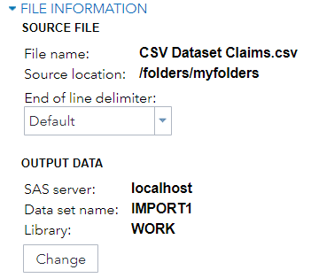
Data Overview
Import
Now that our CSV file is in the correct format we are ready to move the data to SAS/SUE
We will stick to default filenames, i.e we will be naming the file IMPORT in the WORK directory
PROC IMPORT DATAFILE=REFFILE
DBMS=CSV
OUT=WORK.IMPORT1;
GETNAMES=YES;
RUN;
PROC CONTENTS DATA=WORK.IMPORT1; RUN;
Notes:
Discuss the different ways we can work with SAS either the command line or the GUI, everything will be set to default to aid in following along with the presentation

Slide 7
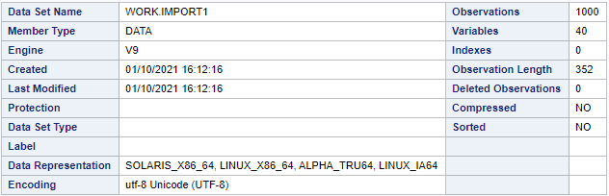
Data Overview
Success!
Notes:
This is the output for a successfully imported table.

Slide 8
Data Overview
Table Familiarization
To get started we will use a summary statistics procedure on the table with total claim amount as the analysis variables and the eight risk factors as classification variables
This produces a 350 page Summary Statistics Full Output in which every classification variable has measures of center and spread as they apply to the analysis variable, total claim payout.
Reviewing this document, we were able to get a good feel over what our table is made out of and what types of strategies may be useful in approaching this BI solution
Notes:
Again, making sure to note that all the relevant docs, while massive in size are easily accessible in GitHub if you are following along at home and have a potato for a PC you can still use the outputs from my analysis.

Slide 9
Data Analysis
Multivariate N-Way ANOVA
Before we can start thinking about making a model used in production we need to determine whether our sample is robust enough to be statistically significant. Our stated Null Hypothesis is that there is no correlation between a risk factor and the claim’s total payout
What this means is that assuming our null hypothesis is false, we need to have less than a 5 percent chance of encountering data as or more extreme in the actual population as the data we have randomly selected for our survey. To do this we will use a multifactor analysis of variance, or ANOVA for short.
Notes:
We used multivariate ANOVA to determine whether or not our sample was statistically significant

Slide 10
Data Analysis
Multivariate N-Way ANOVA
As observed, three of our identified risk factors meet the significance threshold alpha = 0.05 and five risk factors did not. We will move forward with analysis on Age, Sex, and Education Level as indicators of a claim’s potential payout dollar amount.
N-Way ANOVA Here is the full table of our results. This table took my 16 core PC 20 minutes to run, which equates to approx 5.5 hours of CPU time. Here is the code if you would like to follow along at home.
proc means data=WORK.IMPORT chartype mean std min max n vardef=df;
var total_claim_amount;
class age auto_make insured_education_level insured_relationship insured_sex
months_as_customer policy_state umbrella_limit;run;
Notes:
Not all of our results were significant at confidence level alpha = 0.05 we should not use this sample to build a production model on things like vehicle make, vehicle year umbrella limits, duration before first accident, relationship status, and vehicle base state. While not a significant risk factor (scope of this slideshow) base state is important in calculating base rate per zip code even

Slide 11
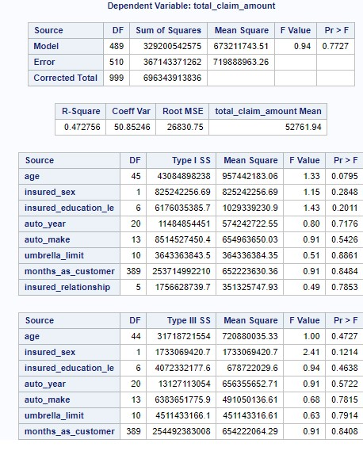
Data Analysis
Multivariate N-Way ANOVA
Notes:
We will be moving forward with age, sex and, education based on their high F scores at significance level alpha = 0.05

Slide 12
Data Analysis
Logarithmic Scale Factor
When we look back to our Summary Statistics histograms we can see that total claim payouts are sharply divided between claims for simple property damage, (i.e. fender benders) and claims for Bodily Injury, either liability or first party.
The scale of these claim payouts is throwing off our normal distribution making calculations exceedingly difficult. If possible we should use a simple data transformation to change our linear claims payout values to logarithmic scale. This brings the claims payout amounts into a more normal distribution for simplified analysis, here is the code
data work.transform;set WORK.IMPORT;tr1_total_claim_amount=LOG(X);run;
Notes:
Claims payouts vary wildly from bumps in the parking lot to multiple fatalities, for some (but not all!) analysis it makes sense to bring our scale factor back to the same page, a super easy transformation can be accomplished is SAS with the aforementioned code

Slide 13
Data Analysis
Male vs Female T-Tests
The prejudice that women are worse drivers than men has probably existed since the invention of the automobile, but is true? Let’s do a T-Test and find out! (University of California, 2020)
As we are examining 2 sexes, we will run a two-sample t-test with claim amount as the analysis variable, and insured sex as the grouping variable:
proc univariate data=WORK.IMPORT normal mu0=0;ods select TestsForNormality;class insured_sex;var total_claim_amount;run;
proc ttest data=WORK.IMPORT sides=2 h0=0 plots(showh0);class insured_sex;var total_claim_amount;run;
Notes:
‘Female Drivers No Survivors!?’ Not so fast! Let’s do a T Test and try to debunk a stereotype/prejudice

Slide 14
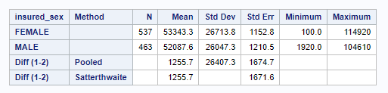
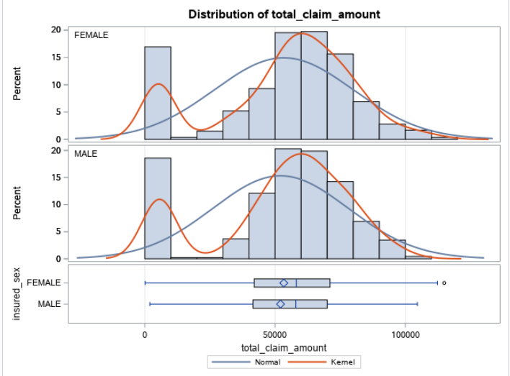
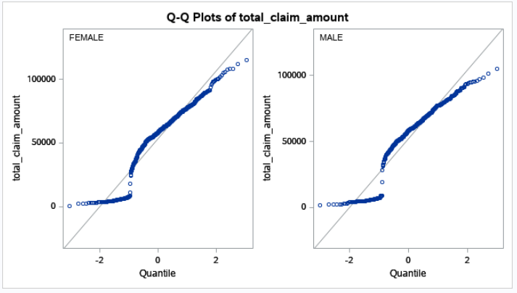
Data Analysis
Male vs Female T-Tests
Notes:
What do we see from the data? I think we’ve busted this myth, look at the measures of center and spread in the table, we will not be differentiating between males and females in our premium pricing model.

Slide 15
Data Analysis
Partial Least Squares Regression - Education Level
Similar in nature to a principal components regression, the partial least squares regression model was used to determine how important is a certain level of education is in relation to total claim payout, We expected to see a somewhat positive linear correlation as education level increased we expected it’s variable importance to increase as well but this is not what the data shows.
As expected, High School education was the least important variable, followed by college, but then we max out importance at associates degree, followed by Juris Doctor, Masters, PhD, and 2nd highest were the MD’s.
While not perfectly correlated, we can still create an incentive based model for insured members to continue pursuing their education.
Notes:
We did not get the expected result when we ran this analysis and that’s OK! That happens all the time and is the meat and potatoes of this business, it means something is there that we aren’t considering properly.

Slide 16
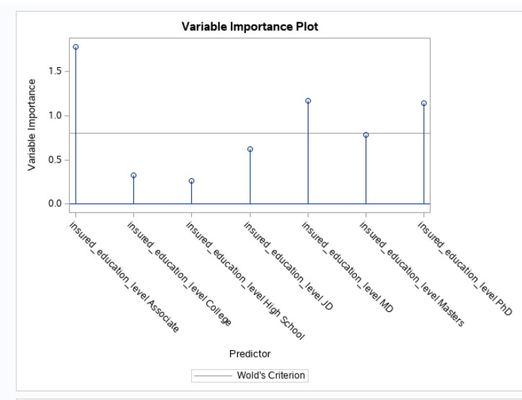
Data Analysis
Partial Least Squares Regression - Education Level
Notes:
We did not get the expected result when we ran this analysis and that’s OK! That happens all the time and is the meat and potatoes of this business, it means something is there that we aren’t considering properly.

Slide 17
Data Analysis
Linear Regression - Age
Age turned out to be the most statistically significant indicator in our ANOVA analysis.
As such, we will use it as a direct indicator of risk and adjust premiums via surcharge for members who are advancing in age, but by how much?
Let’s examine a simple linear regression with age on the x axis and total claims payout as the y-axis.
We will approximate the slope of the regression and use it to determine percentage surcharge each year after the member reaches median age of 43 years old, compounded yearly.
Notes:
Age was the most statistically significant factor in a claim total payout per our ANOVA study. Let’s make a our model directly correlated to a members age after they are older than the median age of 43. But how much is fair?

Slide 18
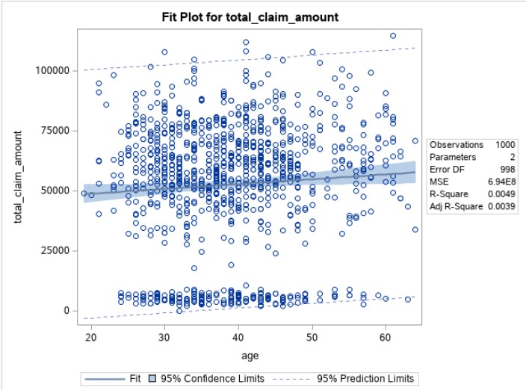
Data Analysis
Linear Regression - Age
As we can see we have a positive regression whose equation can be approximated as y=133x+47300
As such, when a member reaches age 43 we will apply a 1.33% surcharge compounded yearly.
Notes:
Age will be a direct factor for our premium model, as a member turns 43, we will begin to add 1.33% more each year they renew their policies. The rate will remain constant, however the dollar amount will grow as the surcharge compounds yearly.

Slide 19
Model
Premium Credits and Surcharges
As we have established thru data we have three statistically significant risk factors of having a high total claim payout, Sex, Education Level, and Age
We will apply a stick and carrot type model rewarding continued academic progression and surcharging advancement in age.
The credits should have potential to offset the surcharges, and maximum credit should be able to provide a net savings to a member with a clean claims history.
High School Diploma gets no credit. College (Bachelor's Degrees) will receive a 0.75% credit, Master’s and JD will receive a 1.5% credit, MD’s and PhD’s will receive the maximum 3.0% credit.
Drivers without a claim in 5 years can waive the age surcharge. Base Rates by Zip Code
Notes:
Age will be a direct factor for our premium model, as a member turns 43, we will begin to add 1.33% more each year they renew their policies. The rate will remain constant, however the dollar amount will grow as the surcharge compounds yearly. This can be avoided by maintaining a clean driving history for 5 years. Education goes High School = 0, College = 0.75, Masters JD = 1.5, MD PhD = 3.0

Slide 20
Summary
Auto Insurance Premium Pricing Model
We imported our data into SAS and familiarize ourselves with our table’s content by exploring the summary statistics measures of center and spread and outliers.
N-Way ANOVA eliminated 5 out of our 8 variables for not being statistically significant
We were left with Age as most significant, followed by Gender, and Education Level
We used simple linear regression on age to calculate a 1.33% surcharge on members over 43 years of age and have had an accident within the past 5 years
We determined there to be no statistical difference between male and female drivers and will not use sex as a premium factor
We will reward continued education in our model with an escalating credit scale for continued education.
We hope to retain good drivers and adequately price risk of riskier drivers with this model
Notes:
I had so much fun pursuing this degree I hope I find a good job where I can do this kind of work for a living! Thanks Dr. den Heijer for a great class experience

Slide 21
References
Mazenko, E. (2020, June 01). Tableau Software 2020 Review. Retrieved November 30, 2020, from https://www.betterbuys.com/bi/reviews/tableau-business-intelligence/
The University of California. (2020). HOME. Retrieved December 14, 2020, from https://stats.idre.ucla.edu/sas/output/proc-ttest/

